Slide 1

Bangladesh University Of Business & Technology
Course Title: Software Development –I
Course Code : CSE -100
Project Name: Quiz Game

Slide 2
Submitted To: Partho Ghosh Lecturer ,Department of CSE Bangladesh University of Business & Technology
Submitted By : 1.Meher Afroz Binu - 21224103077
2.Tasnia Sultana Hema - 21224103078
3.Nazifa Jerin Reshni - 21224103060
4.Shefat –E –Ara Khan - 21224103069

Slide 3
Content *Introduction *Motivations *Objectives *Features *Conclusion

Slide 4
Introduction
This Project gives a Summary to our work for the game. It has a quiz part that will increase a user Knowledge.
This game is fun to play and play the game.

Slide 6

Motivations
*This game motives user to create a new question.
*Motive to learn Something.
*Through this game it about fun. But this game help to increase any students brain .Because quiz question is about general knowledge.

Slide 7

Objectives
*Testing identifies gaps in knowledge.
*Testing produces better organization of knowledge by helping the brain organize material in clusters to allow better retrieval .

Slide 8
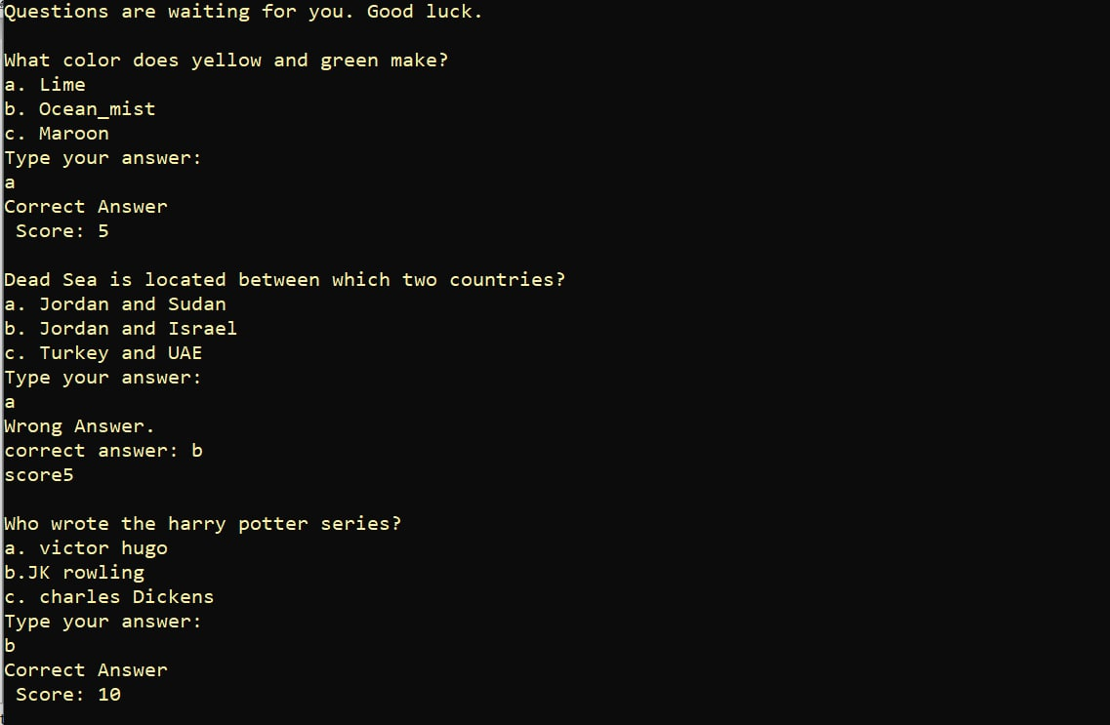
Quiz Question

Slide 9
Features *Show quiz score . *view correct answer options. *view questions results. *Collect Question from file. *Randomize question. *Outcomes screen at end of quiz.

Slide 10
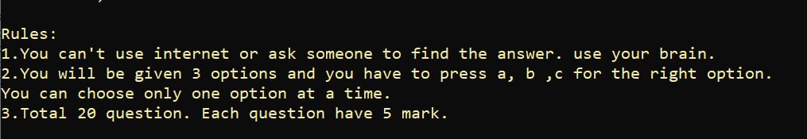
The Rules to the play game

Slide 11
Conclusion
*Every things has two sides negative and positive.
*After all one thing we create ,this game for fun.
*We respect every one to take the game positively.

Slide 12
Thank You

